Slide 1

Gang Test
Gtlee
2006.3.16

Slide 2
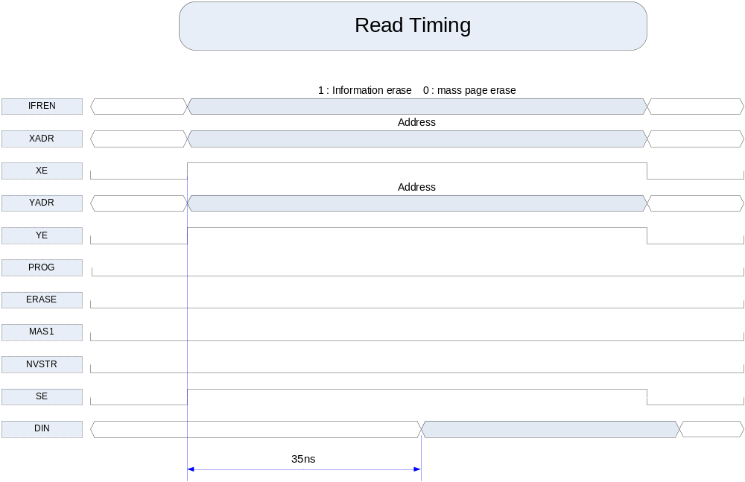
TSMC Flash Timing(1)

Slide 3
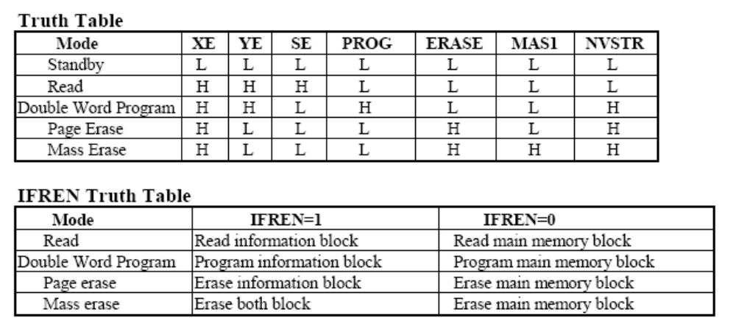
Control Signals Truth Table

Slide 4
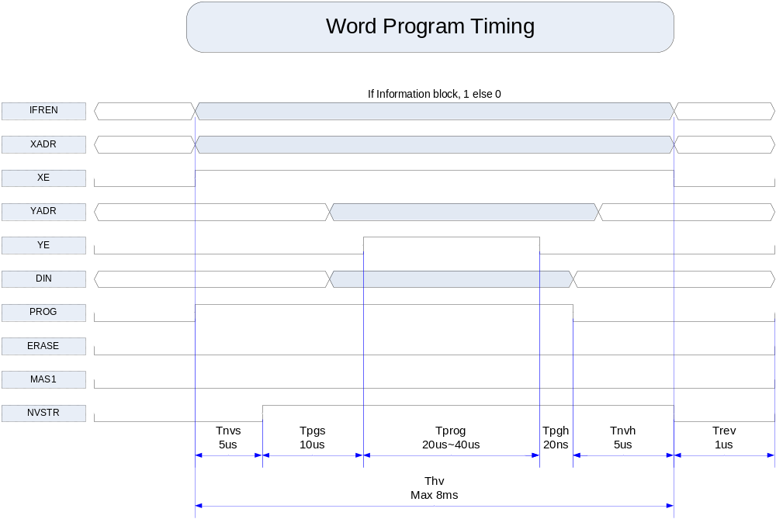
TSMC Flash Timing(2)

Slide 5
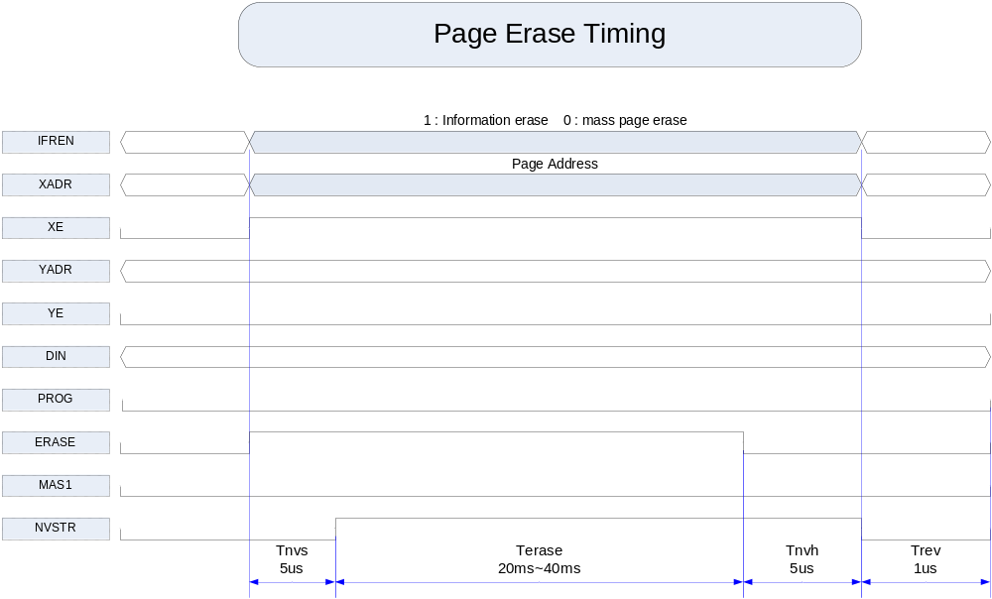
TSMC Flash Timing(3)

Slide 6
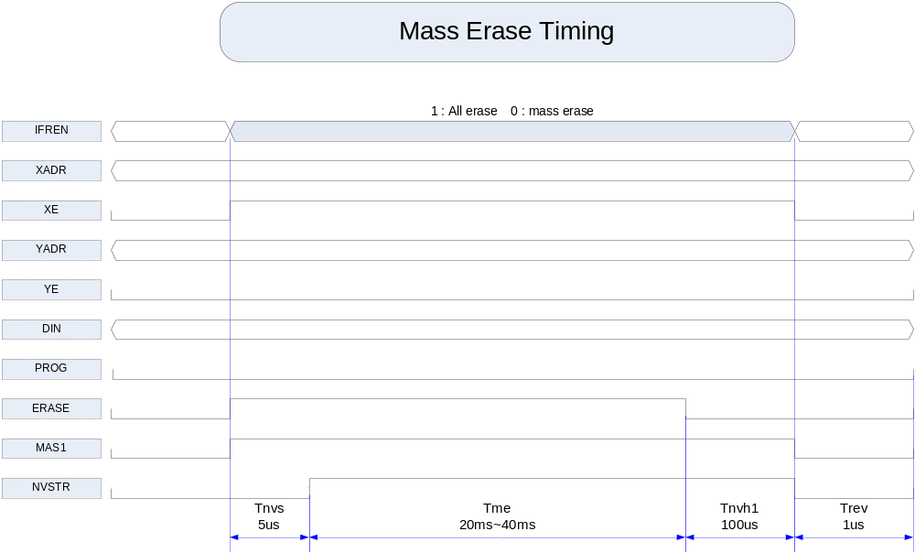
TSMC Flash Timing(3)

Slide 7
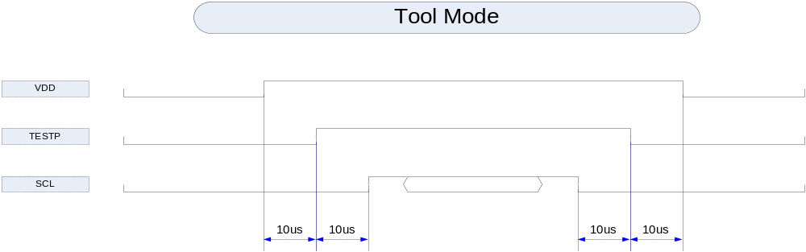
Tool Mode Timing
32 clock동안 TESTP와 SCL을 high로 유지하면 Tool Mode로 진입.
TESTP를 low로 내리면 Tool Mode Off

Slide 8
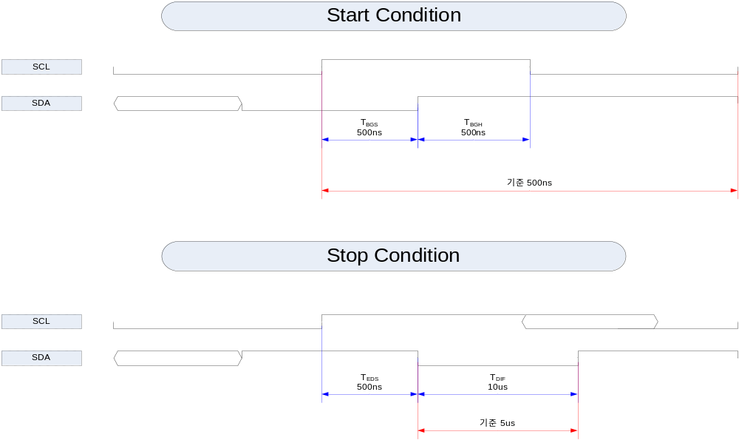
Gang Timing(1)

Slide 9
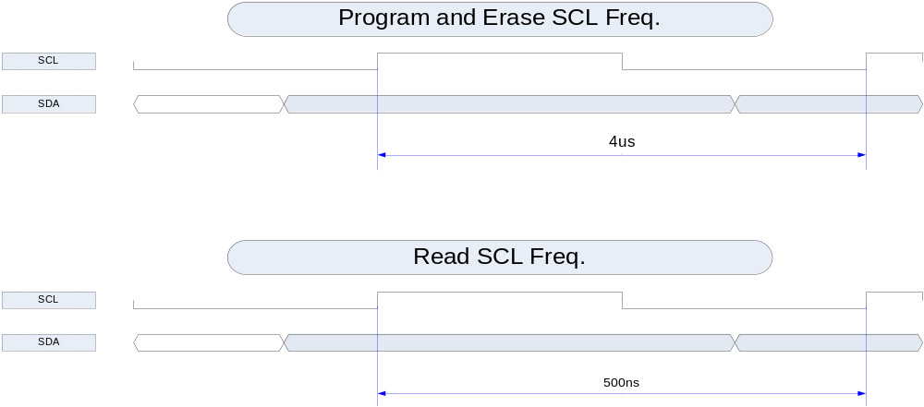
Gang Timing(2)

Slide 10
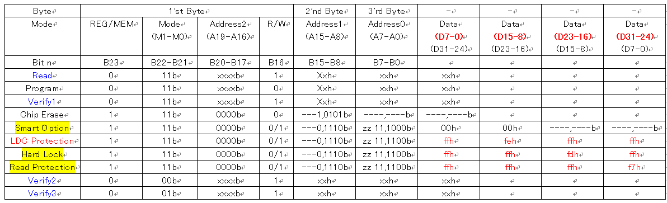
Gang Operations
x : user set
- : don’t care

Slide 11
Program Timing
SDAT
PROG
zone
SCLK
S
1
2
~
7
8
9
1
2
~
7
8
9
1
2
~
7
8
9
1
2
~
7
1
2
~
7
8
9
1
2
~
7
8
9
1
2
~
7
9
P
A23
A22~A17
A16
Dummy
A15~A8
Dummy
A7~A0
Dummy
D7~D0
D7~D0
Dummy
D7~D0
Dummy
D7~D0
Dummy
Clk
Clk
Clk
Data
Clk
Clk
Clk
1st-3rd Byte(Address Field)
Data
+
3
Data
+
4
Data
+
(
n%4)
Data
=
  FFFFh→
Word
t
PGM
In the case of 32bit Product,
2byte Dummy Data 0xFFFF
should be Inserted to avoid
the timing violation
At
least,
PROG
zone
>
T
prog
+
T
nvh
PROG timing diagram of F/M Core, when user programs last data to F/M
T
T
prog
prog
NVSTR timing diagram of F/M Core, when user programs last data to F/M
T
nvh
Disable Timing of this signal is controlled by Internal Counter of FMC
Need 8bit dummy data.
Stop condition에서 sda는 5us동안 low이어야 함.
PROG zone : 마지막 데이터가 write되는 시간 동안 8bit garbage data를 전송
Stop시에는 SDAT가 최소 5us동안 low로 되어야 한다.

Slide 12
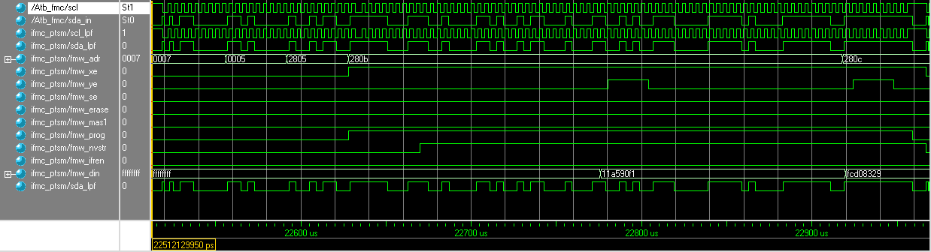
Program SIM

Slide 13
Erase Timing
ERASE
SDAT
zone
SCLK
S
1
2
~
7
8
9
1
2
~
7
8
9
1
2
~
7
8
9
1
2
~
7
8
9
1
2
~
7
8
9
P
A23
A22~A17
A16
Dummy
A15~A8
Dummy
A7~A0
Dummy
D7~D0
Dummy
D7~D0
Dummy
Clk
Clk
Clk
Clk
Chip Erase Delay
Clk
Data
-
FFH
Data
1st-3rd Byte(Address Field) – E0H,
55H,
FFH
=
FFFFFFFFh
t
FFh
  This canbeH/35H/75H/95H/B5H/D5H/F5H
Don't Care of this Value
CED
Don't care of this value
Disable Timing of this signal is controlled by Dummy clock
MAS timing diagram of F/M Core
NVSTR timing diagram of F/M Core
T
cers
T
nvhl
ERASE timing diagram of F/M Core
At
least,
ERASE
zone
>
T
nvhl
100us
T_{CED} must be 20~40ms.
Dummy Data are 8bits.

Slide 14
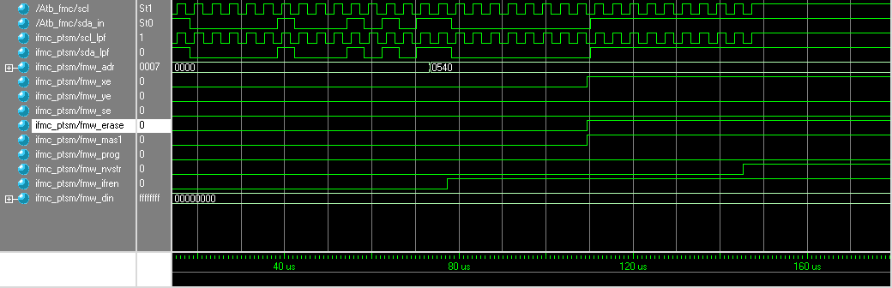
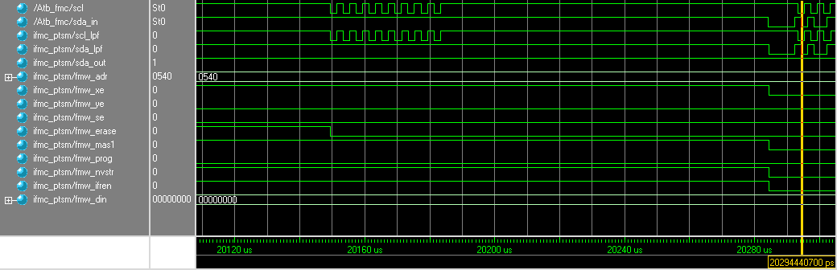
Erase SIM

Slide 15
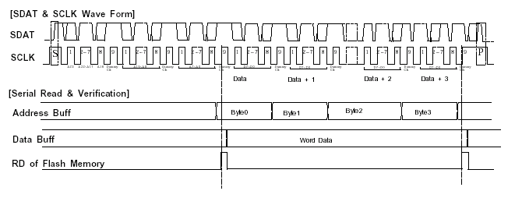
Read Timing

Slide 16
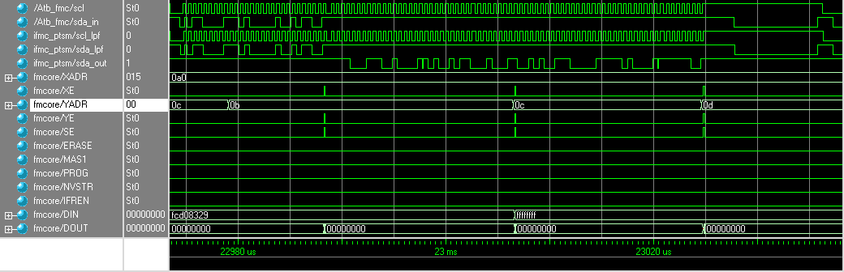
Read SIM

